Slide 1
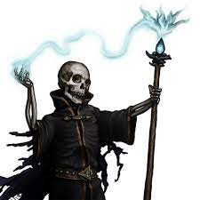
The Night of the Liche
Pitch Date: 12/18/2022 Update 1/29/2023
Release Date: 4/9/2023 123 Commits
Team Lead: Vince McKeown 9 Contributors

Slide 2
Vince McKeown
Coding
Started on Player/Enemy Cards
Ground Objects
Skeleton/Alchemist
Animated Skeleton (all directions and Alchemist Walk (S,W, and E)
New Spirit Class
Animated (N, W, S, and E)

Slide 3
Tylor Allison
Animated Household Candle

Slide 4
H
Graveyard and Village scenes are now travelible.

Slide 5

Christer “McFunkyPants” Kaitila
Enhanced the darkness and lighting effects
Entire screen drawn dark and NPCs, Players, Objects can emit light
Added Quest GUI sprite

Slide 6

Paul Naser
Added forest background sound

